Slide 1
Art and Imagination 3. Making Art Speak
Professor Fergus McGhee
Corpus Christi College

Slide 2
1. Writing the Renaissance
2. Gallery-Going
3. Making Art Speak
4. Art for Art’s Sake?

Slide 3
ekphrasis
from Greek, ἐκφράζειν (to speak out)
ἐνέργειᾰ (vividness)

Slide 4
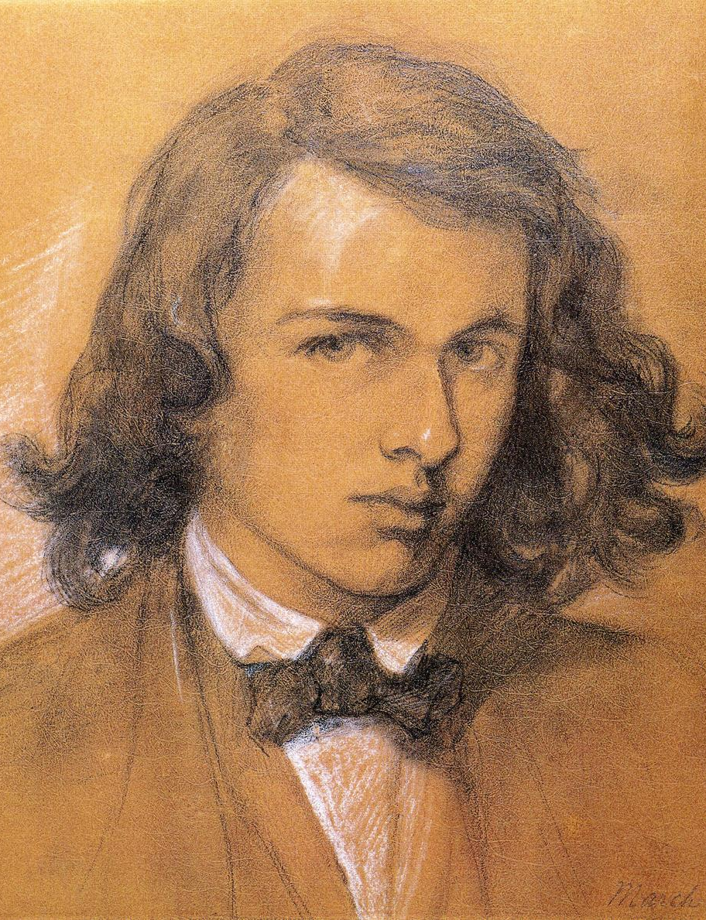
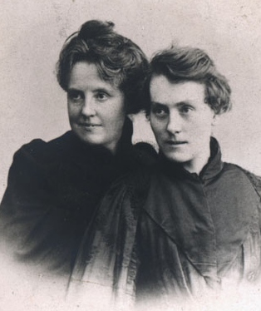
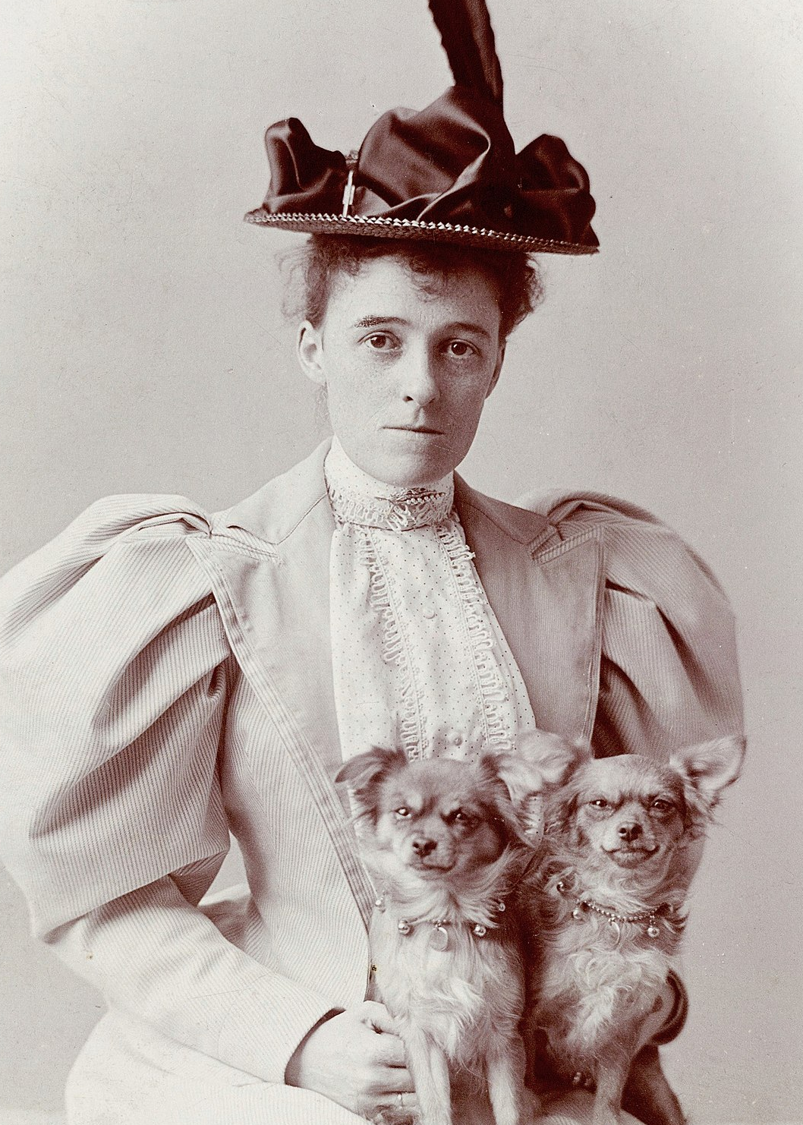
Dante Gabriel Rossetti Michael Field Edith Wharton
(Katherine Bradley & Edith Cooper)
1828-1882 1846-1914 & 1862-1913 1862-1937

Slide 5
What does the poet see – or seek – in the work of art?
What kind of stance does the poem take towards it? Is it engaged in a struggle with the artwork, or offering it a kind of sociability?
apostrophe: address to the artwork
prosopopeia: envoicing the silent object
Where is the speaker in relation to the object?
Where is the reader in relation to the speaker?

Slide 6
ut pictura poesis: ‘as is painting, so is poetry’
Horace (1st century BC)
‘a verbal representation of a visual representation’
J. W. Heffernan, Museum of Words: The Poetics of Ekphrasis from Homer to Ashbery (1993)
‘painting is mute poetry, and poetry is a speaking picture’
Plutarch (2nd century AD, attributed to Simonides of Ceos, 6th century BC)

Slide 7
paragone: rivalry
‘The rule is this, that succession in time is the province of the poet, coexistence in space that of the artist.’
Gotthold Ephraim Lessing, Laocoön: An Essay on the Limits of Painting and Poetry (1766)
‘Lessing has disclosed what is probably the most fundamental ideological basis for his laws of genre, namely, the laws of gender … Paintings, like women, are ideally silent, beautiful creatures designed for the gratification of the eye, in contrast to the sublime eloquence proper to the manly art of poetry.’
W. J. T. Mitchell, Iconology: Image, Text, Ideology (1986)

Slide 8
‘ekphrasis is dynamic and obstetric, delivering from the pregnant moment of visual art the extended narrative which it embryonically signifies’
J. W. Heffernan, Museum of Words (1993)
‘the poem knows something or tells something that had been held back by the silent image’
Stephen Cheeke, Writing for Art: The Aesthetics of Ekphrasis (2008)

Slide 9
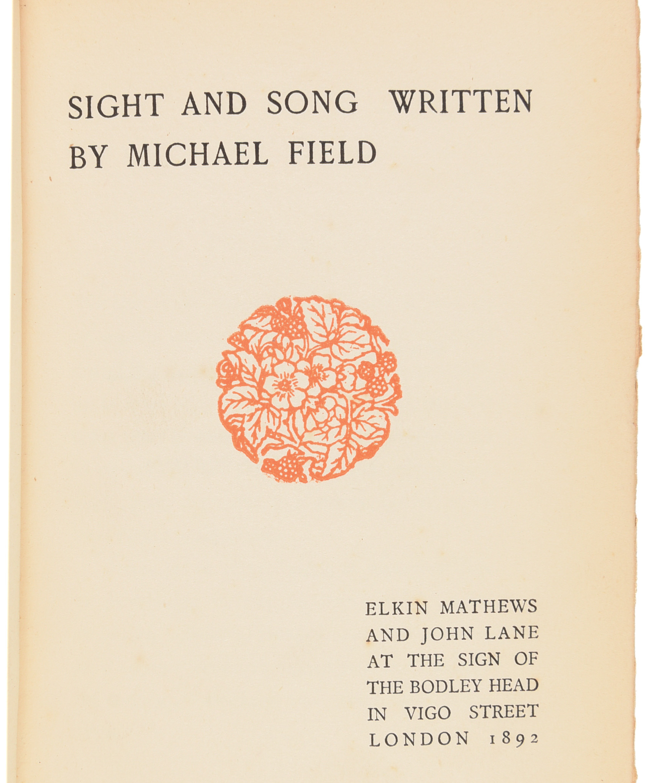

Slide 10
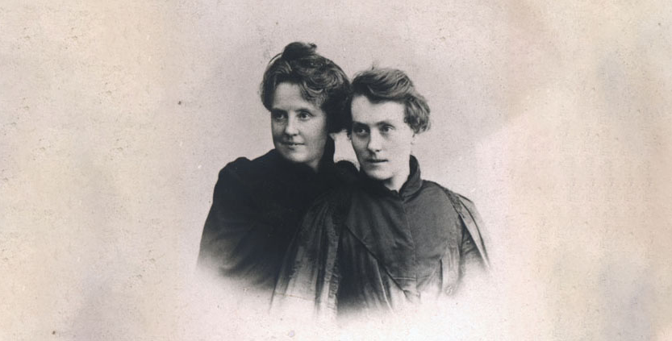
Katherine Bradley
Edith Cooper
Michael Field

Slide 11
‘they have preferred to work with the studious and interpretive side of the mind and write a guidebook to the picture galleries of Europe, instead of giving us a book full of the motions and fancies which must be crowding in upon their minds perpetually.’
William Butler Yeats, review of Sight and Song, The Bookman (1892)

Slide 12
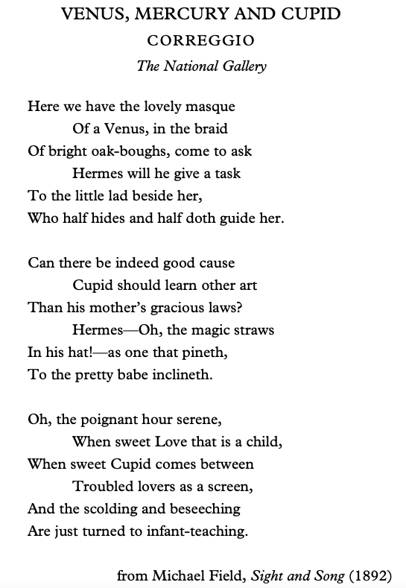

Slide 13
‘to express not so much what these pictures are to the poet, but rather what poetry they objectively incarnate.’
‘Preface’ to Sight and Song (1892)
‘They are deeply poetic pictures at Frankfurt, nay more there are poems in them & one has only to stare & wait till they give up their secret.’
Katherine Bradley to Mary Costelloe, 1891

Slide 14
‘“Il faut, par un effort d’esprit, se transporter dans les personnages et non les attire à soi.” [“One must, by an effort of mind, transport oneself into the characters and not draw them towards oneself.”] For personnages substitute peintures, and this sentence from Gustave Flaubert’s “Correspondence” resumes the method of art-study from which these poems arose.’
‘Not even “le grand Gustave” could ultimately illude himself as a formative power in his work – not after the pain of a lifetime directed to no other end. Yet the effort to see things from their own centre, by suppressing the habitual centralisation of the visible in ourselves, is a process by which we eliminate our idiosyncrasies and obtain an impression clearer, less passive, more intimate.
‘When such effort has been made, honestly and with persistence, even then the inevitable force of individuality must still have play and a temperament mould the purified impression’
‘Preface’ to Sight and Song (1892)

Slide 15
‘Impersonality in art, the literary ideal of Gustave Flaubert, is perhaps no more possible than realism. The artist will be felt; his subjectivity must and will colour the incidents, as his very bodily eye selects the aspects of things.’
Walter Pater, ‘Life and Letters of Gustave Flaubert’, Pall Mall Gazette (1888)

Slide 16
‘The aim of this little volume is, as far as may be, to translate into verse what the lines and colours of certain chosen pictures sing in themselves’
‘Preface’ to Sight and Song (1892)
‘It is the mistake of much popular criticism to regard poetry, music, and painting – all the various products of art – as but translations into different languages of one and the same fixed quantity of imaginative thought, supplemented by certain technical qualities of colour, in painting; of sound, in music; of rhythmical words, in poetry. In this way, the sensuous element in art, and with it almost everything in art that is essentially artistic, is made a matter of indifference’
Walter Pater, ‘The School of Giorgione’ (1877)

Slide 17
‘a painting’s semantics of juxtaposition and interval … may trigger a kind of syntax no one has tried before; the all-at-onceness of the image is an incitement to prosody’
T. J. Clark, ‘What is the burglar after?’, London Review of Books (2022)

Slide 18
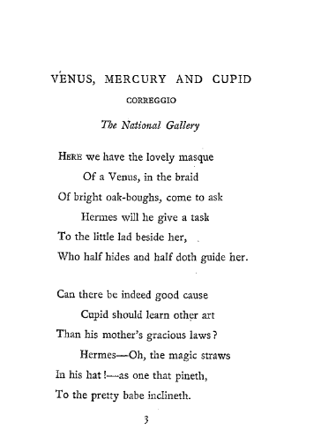

Slide 19
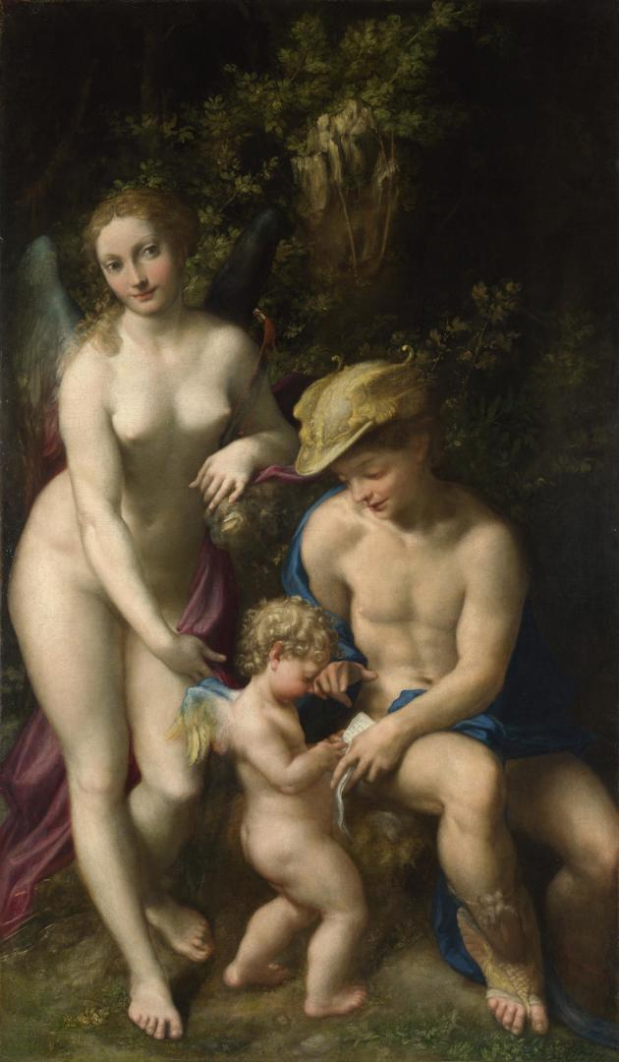
Venus, Mercury, and Cupid
or, The School of Love
Correggio, c. 1525
National Gallery, London

Slide 20
Venus, Mercury, and Cupid
or, The School of Love
Correggio, c. 1525
National Gallery, London

Slide 22
‘the literary topos of ekphrasis in which a poem aspires to the atemporal “eternity” of the stopped-action painting, or laments its inability to achieve it’
Wendy Steiner, Pictures of Romance: Form against Context in Painting and Literature (1988)
Fair youth, beneath the trees, thou canst not leave
Thy song, nor ever can those trees be bare;
Bold Lover, never, never canst thou kiss,
Though winning near the goal yet, do not grieve;
She cannot fade, though thou hast not thy bliss,
For ever wilt thou love, and she be fair!
John Keats, ‘Ode on a Grecian Urn’ (1819)

Slide 23
‘the ekphrastic dimension of literature reveals itself wherever the poem takes on the “still” elements of plastic form which we normally attribute to the spatial arts.’
Murray Krieger, Ekphrasis: The Illusion of the Natural Sign (1992)

Slide 25
‘if a picture is simultaneously available in its entirety, looking at a picture is as temporally linear as language.’
Michael Baxandall, Patterns of Intention: On the Historical Explanation of Pictures (1985)
‘Of course a great picture, like that Leonardo, is made to be seen at several goes. You possess the whole; but you also possess these exquisite details. These things are made for leisurely living with, not to make one bang! impression with a visual image banged into your brain like a seal on wax.’
Vernon Lee, Gallery Diaries (1901-04)

Slide 26
‘No human capacity ever yet saw the whole of a thing; but we may see more and more of it the longer we look. Every individual temper will see something different in it: but supposing the tempers honest, all the differences are there. Every advance in our acuteness of perception will show us something new, but the old and first discerned thing will still be there, not falsified, only modified and enriched by the new perceptions.’
John Ruskin, Modern Painters IV (1856)

Slide 28
Venus, Mercury, and Cupid
or, The School of Love
Correggio, c. 1525
National Gallery, London

Slide 29
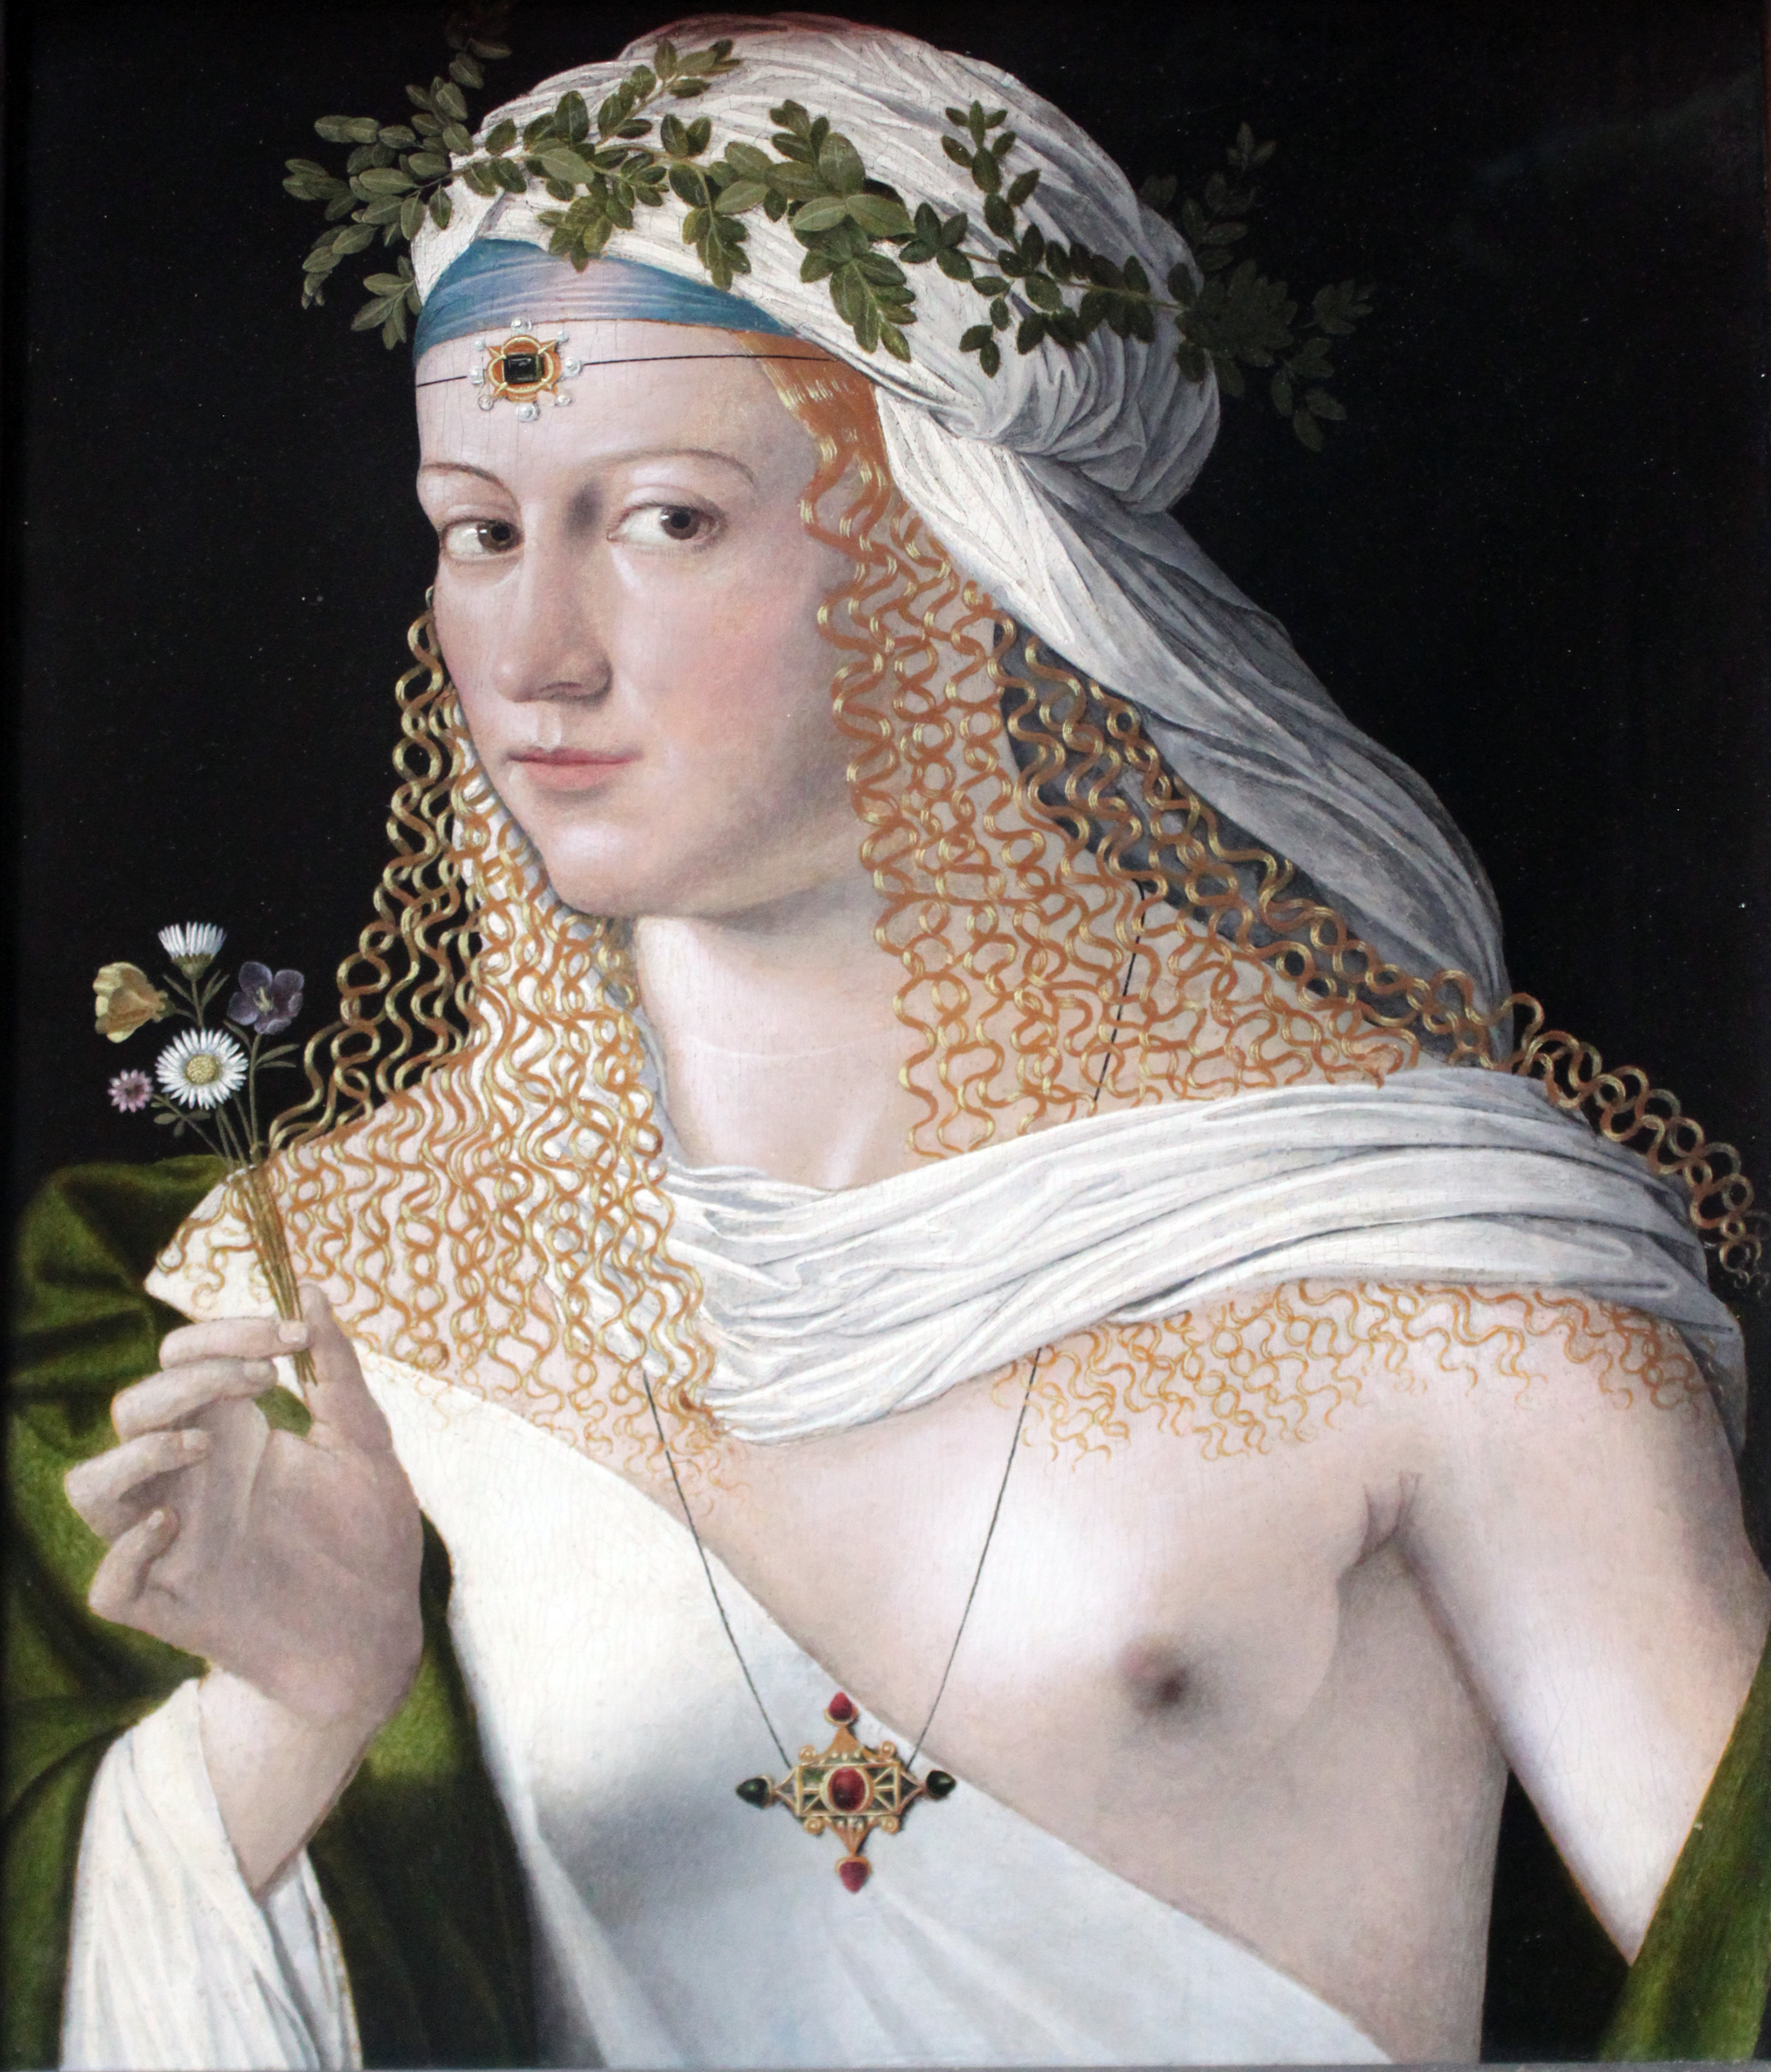
A crystal, flawless beauty on the brows
Where neither love nor time has conquered space
On which to live; her leftward smile endows
The gazer with no tidings from the face;
About the clear mounds of the lip it winds with silvery pace
And in the umber of her eyes it is a light
Chill as a glowworm’s when the moon embrowns an August night.
Michael Field, ‘A Portrait’, Sight and Song (1892)

Slide 30
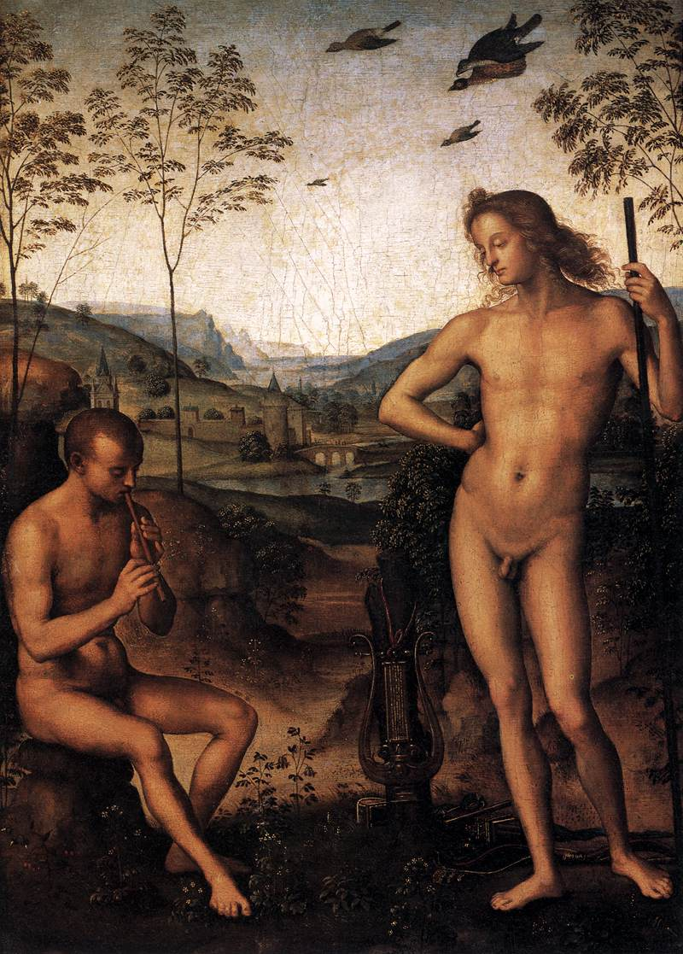
Inscrutably serene the young god stands
In prescience inaccessible, his eyes
Bright with the fumes of mortal sacrifice,
The unfaltering lyre impatient for his hands.
Far valley-ward the mindless pasture-lands
Whose sheltered paths his worshippers despise
Slope to the small walled city where the wise
Move tranquilly within fulfilled demands;
But on the hill-top, challenging the god,
Sits Marsyas, fluting his undaunted tune –
And smiling the god waits, foreseeing soon
The ultimate hour of him whose feet have trod
That perilous Eminence, his bloody swoon,
His end unsorrowed and untended sod.
Edith Wharton, ‘The “Apollo and Marsyas” of Perugino (In the Louvre)’ (c. 1890s)

Slide 31
‘The ambivalence about ekphrasis … is grounded in our ambivalence about other people.’
W. J. T. Mitchell, ‘Ekphrasis and the Other’ (1992)

Slide 32
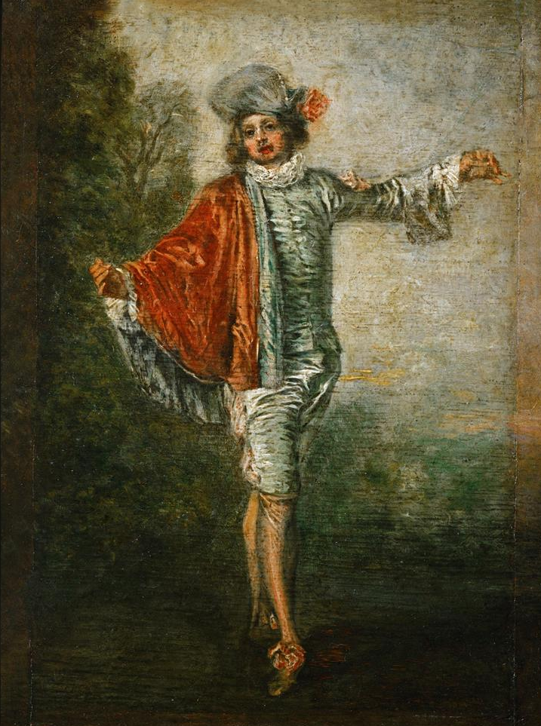
He dances on a toe
As light as Mercury’s:
Sweet herald, give thy message! No,
He dances on; the world is his,
The sunshine and his wingy hat;
His eyes are round
Beneath the brim:
To merely dance where he is found
Is fate to him
And he was born for that.
He dances in a cloak
Of vermeil and of blue:
Gay youngster, underneath the oak,
Come, laugh and love! In vain we woo;
He is a human butterfly;--
No soul, no kiss,
No glance nor joy!
Though old enough for manhood’s bliss,
He is a boy,
Who dances and must die.
Michael Field, ‘L’Indifférent’, Sight and Song (1892)

Slide 33
‘there exist in experience no such abstractions as aesthetic attention or aesthetic enjoyment, but merely very various states of our whole being which express themselves, among other results, in various degrees and qualities of responsiveness to works of art’
Vernon Lee, Æsthetic Responsiveness, its Variations and Accompaniments (1912)

Slide 34
What men or gods are these? What maidens loth?
What mad pursuit? What struggle to escape?
What pipes and timbrels? What wild ecstasy?
John Keats, ‘Ode on a Grecian Urn’ (1819)

Slide 35
‘You know, Phaedrus, that’s the strange thing about writing, which makes it
truly analogous to painting. The painter’s products stand before us as
though they were alive, but if you question them, they maintain a most
majestic silence. It is the same with written words; they seem to talk to you
as though they were intelligent, but if you ask them anything about what
they say, from a desire to be instructed, they go on telling you just the same
thing forever.’
Plato, Phaedrus (4th century BC), tr. R. Hackforth

Slide 36
‘the very word mystery has its origins in the idea of silence’
Walter Pater, ‘The Myth of Demeter and Persephone’ (1876)
Latin, mysterium (secret)
Greek, μύστης (initiate)
Greek, μῡ́ω (to shut)

Slide 37
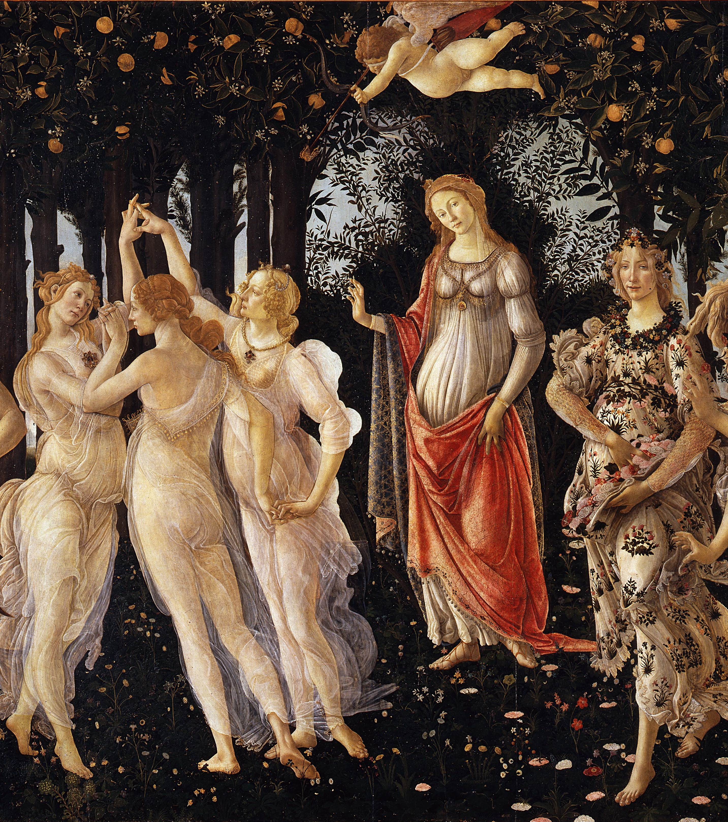
What mystery here is read
Of homage or of hope? But how command
Dead Springs to answer? And how question here
These mummers of that wind-withered New-year?
Dante Gabriel Rossetti, ‘For Spring, by Sandro Botticelli (In the Accademia of Florence)’ (1881)

Slide 38
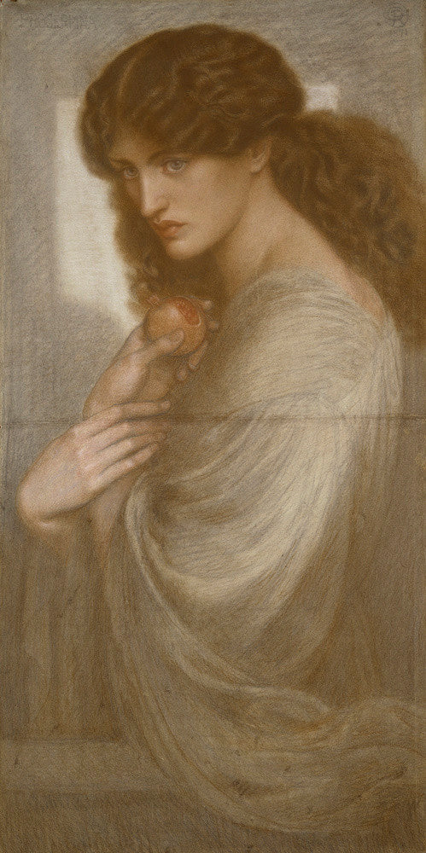
Proserpine (1871)
Dante Gabriel Rossetti
Ashmolean Museum, Oxford

Slide 39
Afar away the light that brings cold cheer
Unto this wall,—one instant and no more
Admitted at my distant palace-door.
Afar the flowers of Enna from this drear
Dire fruit, which, tasted once, must thrall me here.
Afar those skies from this Tartarean grey
That chills me: and afar, how far away,
The nights that shall be from the days that were.
Afar from mine own self I seem, and wing
Strange ways in thought, and listen for a sign:
And still some heart unto some soul doth pine,
(Whose sounds mine inner sense is fain to bring,
Continually together murmuring,)—
“Woe’s me for thee, unhappy Proserpine!”
Dante Gabriel Rossetti, ‘Proserpina (For a Picture)’ (1872)

